Slide 1
General Meeting
March 25, 2015

Slide 2
Joining IEEE
campuslink.uc.edu
Log in
Click “Organizations”
Directory → click “ T ”
Click “IEEE”
Click “Join Organization”
Follow us on Twitter!
@UC_IEEE

Slide 3
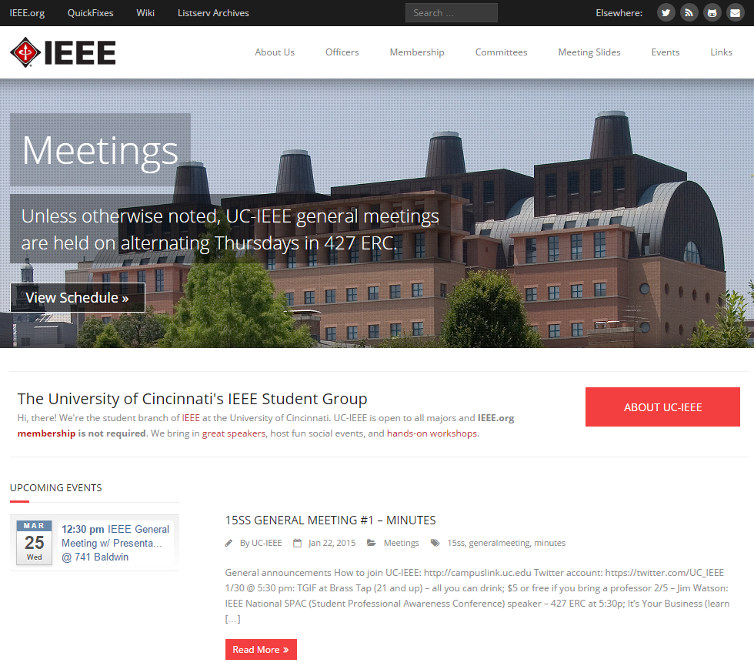
Catch Up on Missed Meetings
Visit our website:
www.ieee.uc.edu
upcoming events
tutoring info
IEEE national info
meeting minutes
meeting slides
from 2011 – present

Slide 4
Upcoming events

Slide 5
TGIF IEEE/HKN/BMES/AIChE
Date: March 27th @ 5:30pm
Brass Tap @ U-Square
Over 21: $5 entry or Free w/ Prof.
2 KEGS!!!
Under 21: Can’t Come ☹

Slide 6
2015-16 Elections
IEEE Officer Positions:
President
Vice President
Treasurer
Secretary
Webmaster
Social Chair
Fundraising Chair
SPAC Chair
When: April 9th @ 5:30
Where: 427 ERC
Interested?
Email Nick Blumenschein at blumennk@mail.uc.edu
for more information or with desired officer position

Slide 7
L3 Communications
When: April 16th @ 5:30
Where: 427 ERC
Presentation by Robert Jones, PhD EE
2007 UC graduate from Nanoelectronics Lab
Specialty in the field of light emitting devices

Slide 8
After Today’s Presentation
Stick around to hear Maggie Connell discus the Order of the Engineer Ceremony

Slide 9
Guest Presentation By: Dr. Cahay
1981 - BS in Physics, University of Liege, Belgium
1986 - MS in Physics, Purdue University
1987 - PhD in EE, Purdue University
289 Publications – have 2,291 citations!
Dr. Cahay joined the UC EECE department in 1989 as an Assistant Professor. Since this time, he has taught a variety of courses and conducted research in the areas of Semiconductor Devices, Quantum Mechanics, and Spintronics.
During this presentation, Dr. Cahay will be discussing his research on experimental and theoretical investigation of field emission from carbon nanotube fibers.

Slide 10
Order of the Engineer
What’s this all about?
Foster a spirit of pride and responsibility in the engineering profession.
Bridge the gap between training and experience.
Present to the public a visible symbol identifying the engineer.
Any engineer is eligible for induction if he or she has graduated/within one academic year of graduation from an EAC of ABET program or holds a license as a Professional Engineer.
Got Questions? Want to help?
connelmt@mail.uc.edu

Slide 11
Order of the Engineer
ATTENTION ALL CEAS SENIORS:
Be part of a time honored tradition that celebrates the spirit of an engineer; Order of the Engineer
Ring sizing NEXT WEEK! (March 30th – April 3rd) in 650 Baldwin (Tribunal office)
Monday – Friday 11:30pm – 2:00pm
Monday 9am- 10am
10$ cash or check made out to “CEAS Tribunal” to pay for ring
Ceremony will be on Friday, May 1st
Can’t make these times:
Email Maggie Connell: connelmt@mail.uc.edu
Notes:
Order of the Engineer is a ceremony that all CEAS seniors can take part in. Engineers take an oath and receive a ring during the ceremony. The ceremony is supposed to foster a spirit of pride and responsibility in the engineering profession and bridge the gap between training and experience.

