Slide 1
General Meeting
February 5, 2015

Slide 2
Joining IEEE
campuslink.uc.edu
Log in
Click “Organizations”
Directory → click “ T ”
Click “IEEE”
Click “Join Organization”
Follow us on Twitter!
@UC_IEEE

Slide 3
Upcoming events

Slide 5
AIChE Marathon Event
When: February 18th @ 5pm
Where: 544/644 Baldwin
AIChE invited our members to attend the event

Slide 6
Tesla Motors
When: February 19th @ 5:30
Where: 427 ERC
Cypress
Semiconductor
Gulfstream
Aerospace

Slide 7
TGIF IEEE/HKN/BMES/AIChE
Date: February 27th @ 5:30pm
Brass Tap @ U-Square
Over 21: $5 entry or Free w/ Prof.
2 KEGS!!!
Under 21: Can’t Come ☹

Slide 8
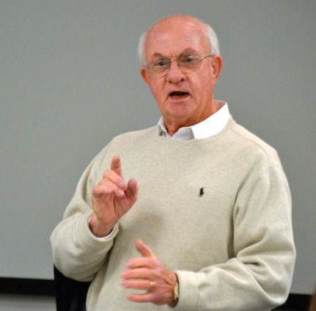
Guest Presentation By:
Jim Watson
IEEE National Speaker
Bachelor’s in EE from Purdue
Graduate of the Executive Management Program at University of Michigan
IEEE Life Member
Worked at Ohio Edison Company for 36 years
Established Watson Associates and has directed this program for more than 25,000 students at 14 major universities
In 2011, IEEE established the “IEEE-USA Jim Watson Student Professional Awareness Award”
Co-author of “Engineering Skills for Career Success”
It’s Your Business

